Slide 1


Efficient LLM Inference with SGLang
Lianmin Zheng
xAI

Slide 2
Content
SGLang overview
Major techniques
Efficient KV cache reuse with RadixAttention
Efficient constrained decoding with compressed finite state machine
Low-overhead CPU scheduling
Torch native optimizations (torch.compile, torchao)
Preliminary benchmark results on MI300
Open-source community and roadmap

Slide 3
SGLang Overview
SGLang is a fast serving framework for large language models and vision language models.

Slide 4

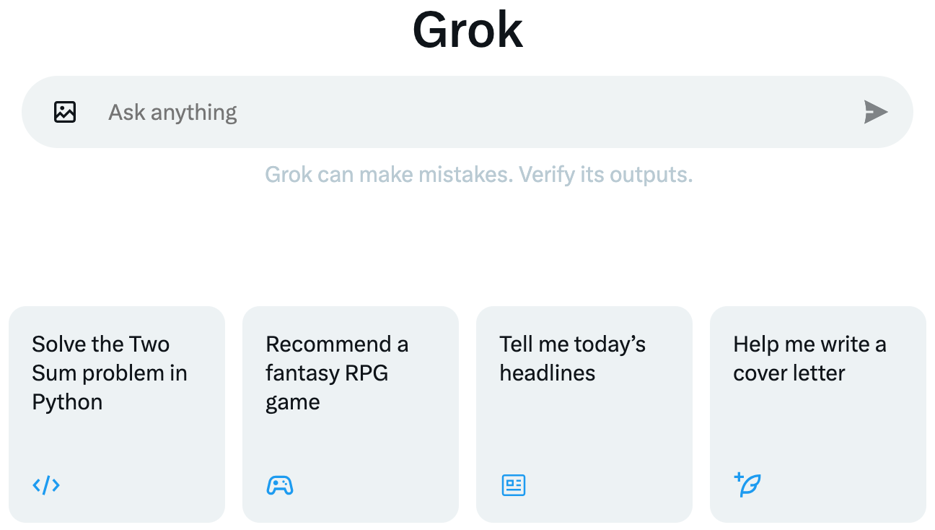
What is SGLang?
A fast inference engine for LLMs
Comes with its unique features for better performance
Serves the production and research workloads at xAI

Slide 5
SGLang provides leading inference performance
Compared to the other popular inference engines:
v0.1 (Jan. 2024)
5x higher throughput with automatic KV cache reuse
3x faster grammar-based constrained decoding
v0.2 (July 2024)
3x higher throughput with low-overhead CPU runtime
v0.3 (Sept. 2024)
7x faster triton attention backend for custom attention variants (MLA)
1.5x lower latency with torch.compile

Slide 6
SGLang architecture overview
Server
API server
Tokenizer
Client
Native generation API
Mode Worker
KV Cache memory pool (page size = 1 token)
Radix tree cache
Finite state machine analyzer
Attention backend (FlashInfer and Triton)
OpenAI-compatible API
Structured language frontend
Detokenizer
Lightweight and customizable code base in Python/PyTorch

Slide 7
Major Techniques

Slide 8
Four techniques covered in this talk
Efficient KV cache reuse with RadixAttention
Efficient JSON decoding with compressed finite state machine
Low-overhead CPU scheduling
Torch native optimizations (torch.compile, torchao)

Slide 9
LLM inference pattern: Complex pipeline with multiple LLM calls
User
Requests
Question
Follow-up question
Clarification
Chained calls
LLM Calls
Answer 1
Answer 2
Answer 3
User
Requests
Question
Parallel calls
Answer 1
LLM Calls
Answer 2
Select
Answer 3
Notes:
In an LLM application, to accomplish complex tasks, it often requires not only a single LLM invocation but the integration of multiple LLM calls.
I will show some common patterns.
The first pattern is chained calls. This figure shows a multi-turn conversation with an LLM. The user can ask a series of questions.
To generate answers, the inference system needs to process a chain of multiple dependent LLM calls.
⬇️ Another common pattern is parallel calls. This figure illustrates a prompting technique involving parallel calls. To answer a user query, we can issue multiple LLM calls in parallel to generate multiple different answers. Then, we can use another LLM call to select the best answer from them. This can improve the solution quality.

Slide 10
LLM inference pattern: Complex pipeline with multiple LLM calls
Chained calls
Multi-call structure brings optimization opportunities (e.g., caching, parallelism, shortcut)
Parallel calls
Notes:
This kind of multi-call structure presents some interesting optimization opportunities, such as cache reuse, parallelism, and shortcuts in execution.
These opportunities can significantly accelerate inference but are largely overlooked by current systems.

Slide 11
There are rich structures in LLM calls
Turn 1 (Q)
Turn 1 (A)
Chat History
Turn 2 (Q)
Turn 2 (A)
(a) Multi-turn chat
Chat History
Turn 3 (Q)
Turn 3 (A)
Chat History
Turn 4 (Q)
Turn 4 (A)
Reusable KV cache (Key-Value cache, some intermediate tensors)
Prompt 1
Few-shot examples
Question 1
Answer 1
(b) Few-shot
learning
Prompt 2
Few-shot examples
Question 2
Answer 2
Prompt 3
Few-shot examples
Question 3
Answer 3
Notes:
Let me explain the structure in LLM calls with more concrete examples. We can start from the most basic use case of LLM, multi-turn chatbot.
In the first turn, the user asks a question, denoted as a green box here. The LLM then generates a response, denoted as a yellow box here.
Most systems just optimize for a single turn, or a single pair of green and yellow box.
⬇️ However, as the chat session continues, the first turn will become the chat history. We will then have turn two, ⬇️ turn three, ⬇️ and more turns.
The chat history here is an accumulated structure with runtime optimization opportunities.
In the LLM generation process,
⬇️ there are some intermediate tensors called KV cache. KV cache is generated during the forward pass and will be used for decoding future tokens. As the KV cache only depends on prefix tokens, so different sequences with the same prefix can reuse the KV cache and avoids the redundant computation and memory usage.
This is only one case. These sharable structures appear in lots of common LLM workloads.
⬇️ Another case is few-shot learning. In the few-shot learning setting, different prompts can share the same set of few-shot examples, so the KV cache of the few-shot examples can be shared. The blue boxes denote the shareable part.
In this slide, all the blue boxes can be reused across multiple LLM calls. However, most existing systems simply recompute all of them every time. This is because they are scattered across multiple calls, making it hard to track the states.

Slide 12
The structures can be very complicated
Parallelizable branches
Question 1
Answer 1
Search History
Q 1.1
A 1.1
Search History
Q 1.1.1
A 1.1.1
Search History
Q 1.2
A 1.2
Search History
Q 1.2.1
A 1.2.1
(c) Tree search
with LLM agents
Question
Question 2
Answer 2
Search History
Q 2.1
A 2.1
Search History
Q 2.1.1
A 2.1.1
Search History
Q 2.2
A 2.2
Reusable KV cache
(intermediate tensors)
Search History
Q 2.2.1
A 2.2.1
(d) Tree-of-thought
Notes:
This kind of structure can go very complicated and dynamic, as illustrated by the following use case.
For example, if you want to use an LLM to solve a hard math problem, we can integrate the LLM into a tree search algorithm, such as depth-first search.
⬇️ This figure illustrates a search tree, where the LLM will explore all branches within the search tree. The LLM will try different directions or branches for solving the problem.
⬇️ In this scenario, different branches of the tree can share the KV cache of the search history from the common parent nodes. This creates a complex, tree-structured sharing, and no existing systems can manage all the reuse opportunities within this tree.
⬇️ Furthermore, you can also image that some branches can run in parallel, as denoted by the orange boxed here.

Slide 13
Technique 1: Efficient KV cache reuse with RadixAttention
Chat History
Turn 4 (Q)
Turn 4 (A)
KV Cache
Some reusable intermediate tensors
Can be very large (>20GB, larger than model weights)
Only depends on the prefix tokens
Existing systems: Discard KV cache after an LLM call finishes
Ours: Maintain the KV cache of all LLM calls in a radix tree (compact prefix tree)
Notes:
I've covered the concept of KV cache in the previous slides.
To briefly recap, let me bring back this chat history figure. The blue part is the KV cache. They are some intermediate tensors. It can be very large, ranging from dozens to hundreds of gigabytes, potentially even larger than the model weights. Additionally, it only depends on prefix tokens.
▶️ In existing systems, once an LLM call is finished, its associated KV cache is discarded. This is because these systems are only optimized for a single LLM call.
However, our goal is to efficiently handle more complex multi-call patterns, such as chained calls and parallel calls.
So, in our design, we never simply discard any KV cache. Instead, we retain the KV cache for both the user input and LLM output within a radix tree. A radix tree is a type of space-efficient prefix tree.

Slide 14
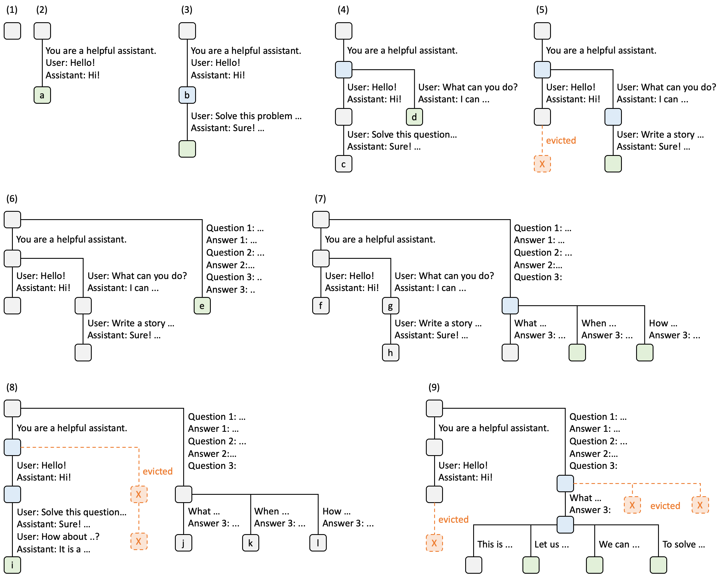
RadixAttention maintains the KV cache of all LLM calls in a radix tree (compact prefix tree)
Notes:
Let me walk you through some examples of how we manage the RadixAttention tree:
▶️ In the first step, the radix tree starts off empty, except for a root node.
▶️ Moving to the second step, the server receives an incoming user message, "Hello," and responds with "Hi" from the LLM. We concatenate the system prompt, "You are a helpful assistant," along with the user's message, "Hello!" and the LLM's response, "Hi!”, all as a single edge. We then link the edge to a new node in the tree. We label each edge with a substring, which is just a sequence of tokens.
▶️ In the third step, the chat session continues and a new prompt is received. The server identifies the prompt's prefix in the radix tree, corresponding to the first conversation turn, leading to a cache hit. This allows us to reuse its KV cache. The the conversation's new turn is then added as another node to the tree. We use colors to distinguish different node states: green for newly added nodes and blue for cached nodes that are being accessed.
▶️ By the fourth step, a new chat session starts. We split the node “b” from the previous step into two separate nodes. This division enables the sharing of the common system prompt.
▶️ Finally, in the fifth step, as the second chat session progresses, we might encounter GPU memory limitations. To address this, we've implemented an LRU eviction policy that recursively removes the leaf nodes. In this scenario, the node labeled "c" from step four is evicted to make room. We use orange to denote the evicted nodes. The new turn is then added into the tree.
You may think that for an online chat server, the tree pattern can be simple because most conversations will just diverge. However, this technique really shines in more advanced use cases, such as the tree search I mentioned earlier and some batch processing job.

Slide 15
RadixAttention handles complex reuse patterns
RadixAttention enables efficient prefix matching, insertion, and eviction.
It handles trees with hundreds of thousands of tokens.
Notes:
Here I show a more complex tree. As you can see, there are more branches and some interesting eviction patterns.
Basically, by maintaining the KV cache within a radix tree, we achieve efficient prefix matching, insertion, and eviction. It is able to automatically handle many reuse patterns.
In practice, we can manage a tree with hundreds of thousands of tokens with very low overhead and a high cache hit rate.

Slide 16
Cache-aware scheduling increases cache hit rate
Idea: Utilize user annotations and runtime metrics for scheduling
Single worker case
Sort the requests in the queue according to matched prefix length
Distributed case
Route the requests to the worker with the matching cache
Notes:
To fully leverage the radix attention, we implemented several policies for cache-aware scheduling that can increase the cache hit rate.
We utilized both user annotations and runtime metrics to achieve this.
On a single worker node, we sort all requests in the queue by the length of their matched prefixes. We then give priority to the requests with the longer matched prefixes.
⬇️ In a distributed setting with multiple workers, we implemented a router that is capable of dispatching requests to the worker with the matching cache. We designed a policy that balances load and cache hit rates for various workloads.

Slide 17
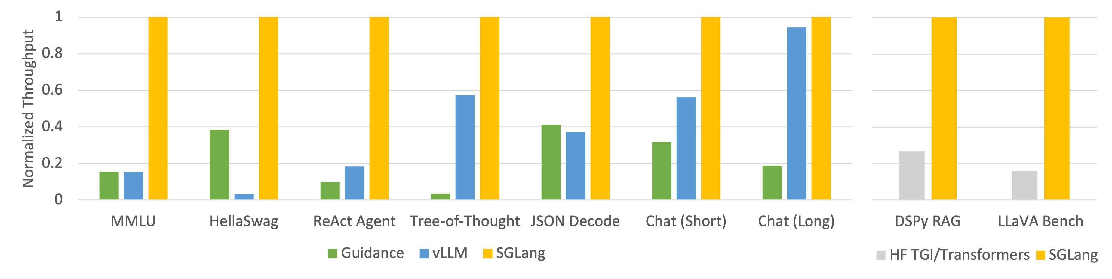
Results: SGLang is fast and flexible
Up to 5x higher throughput with KV cache reuse and parallelism
Works automatically across workloads and text/image tokens
Source: SGLang v0.1 blog, https://lmsys.org/blog/2024-01-17-sglang/
Notes:
The results are very promising.
By leveraging the built-in structure of applications, we are able to increase throughput by up to five times compared to existing systems like vLLM and guidance. As illustrated in this figure, this improvement spans a broad range of LLM workloads. This includes LLM agents, reasoning tasks, few-shot learning benchmarks, JSON decoding, and multi-turn chat sessions. These improvements are mostly achieved by reusing the KV cache across multiple LLM calls and taking advantage of parallelism within a single program.
▶️ Additionally, using SGLang can simplify code complexity and improve control.
This project is still on-going and I will share some future directions at the end of this talk.

Slide 18
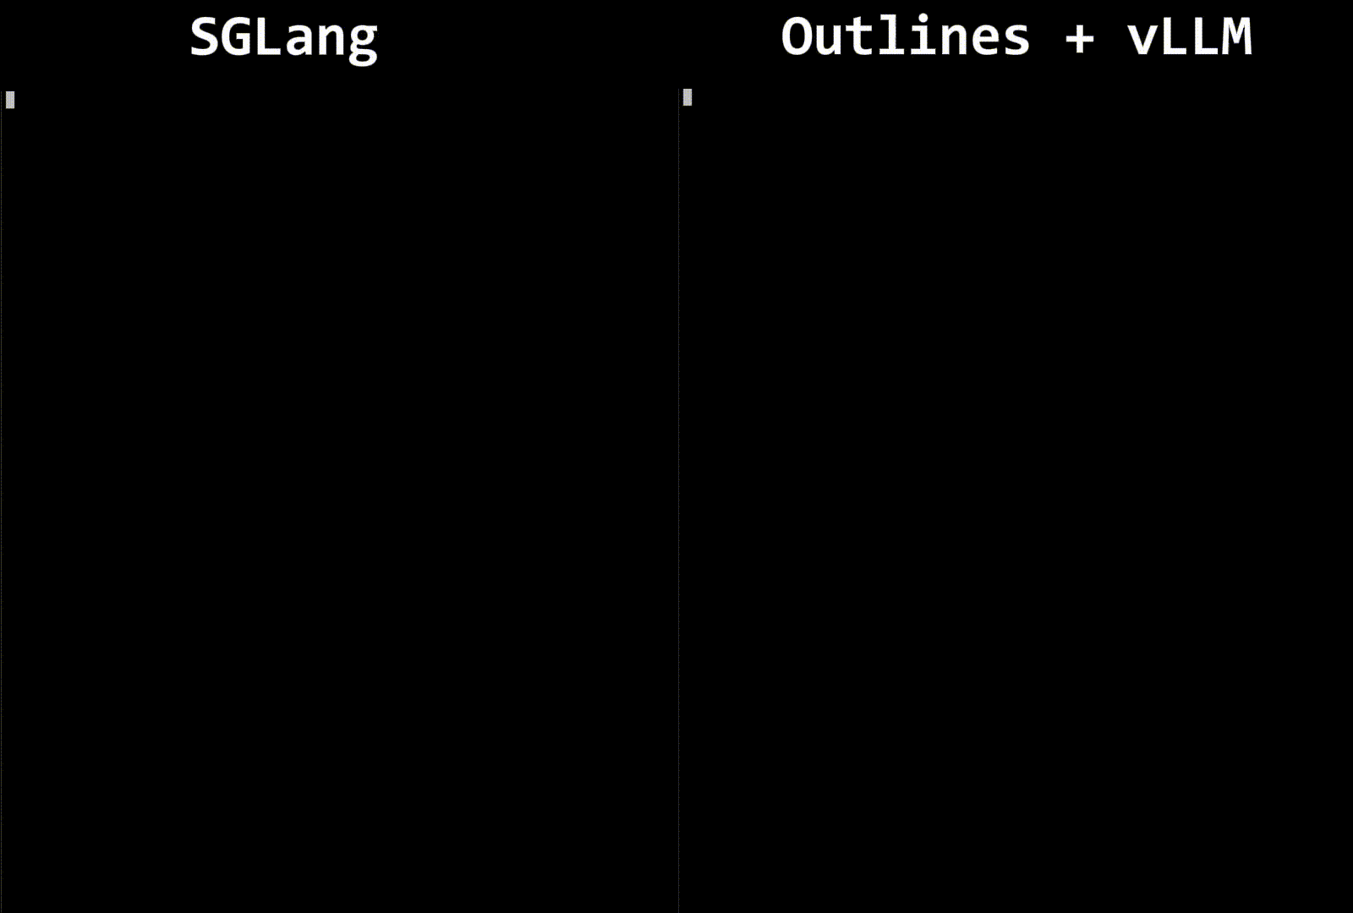
Technique 2: Efficient constrained decoding
Workload: Generate the descriptions of characters in the JSON format

Slide 19
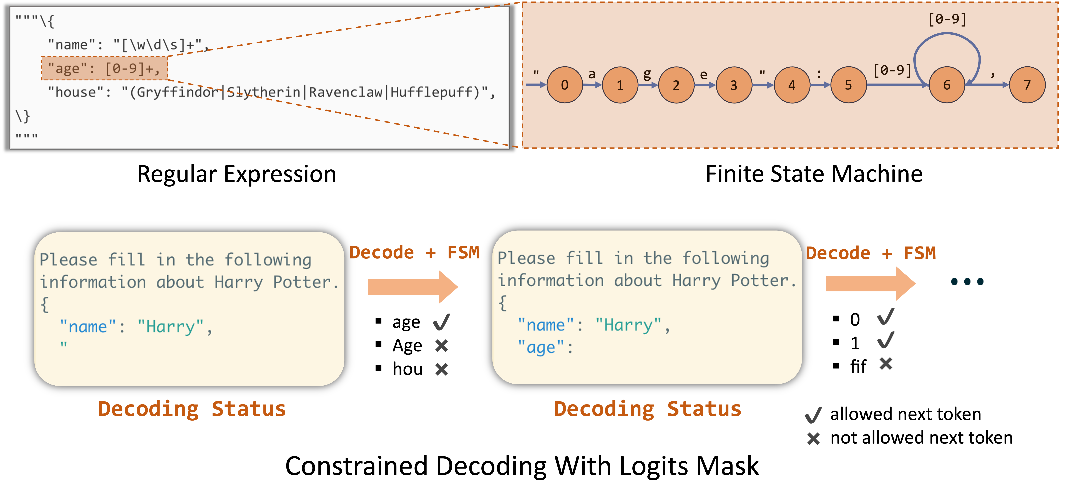
Constrained decoding works by masking the invalid tokens
Constraint decoding: JSON schema -> regular expression -> finite state machine -> logit mask

Slide 20
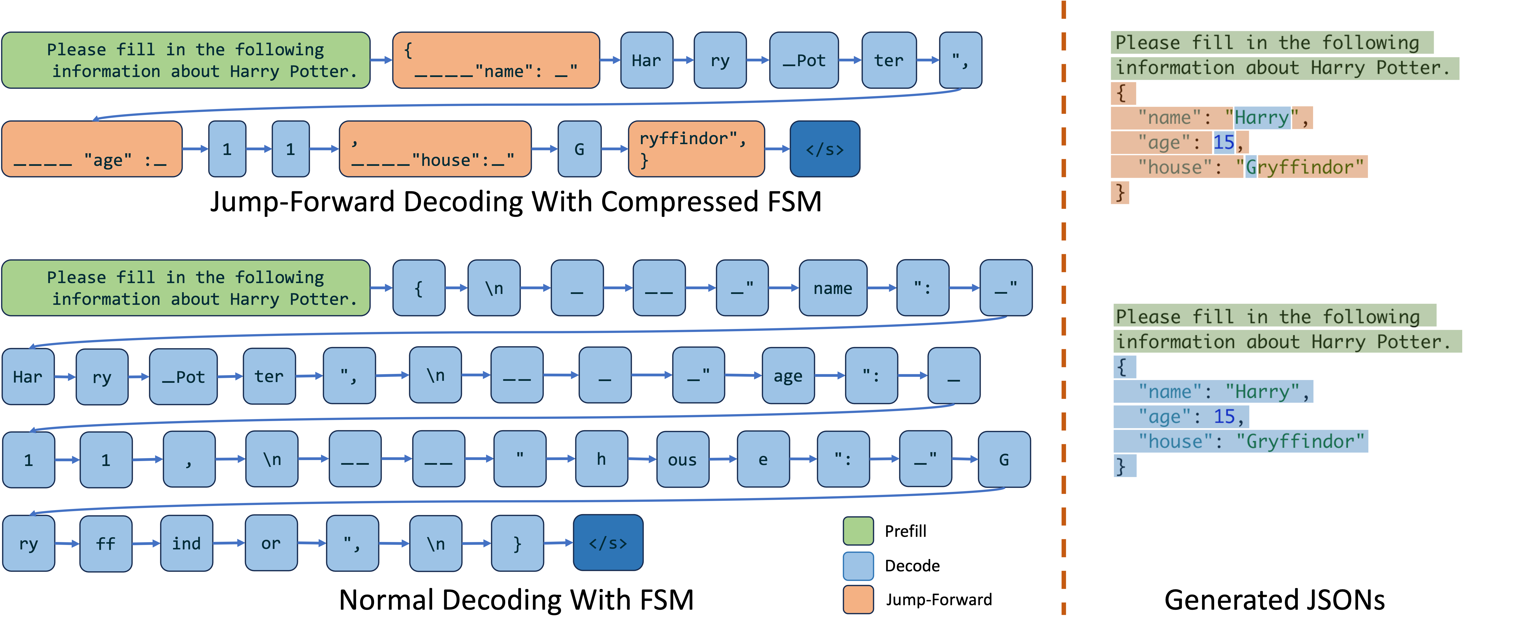
Compressing the finite state machine allows decoding multiple tokens
We can compress many deterministic paths in the state machine

Slide 21
Technique 3: Low overhead CPU scheduling
An unoptimized inference engine can waste more than 50% time on CPU scheduling.
Average iteration time (ms)
Source: https://mlsys.wuklab.io/posts/scheduling_overhead/

Slide 22
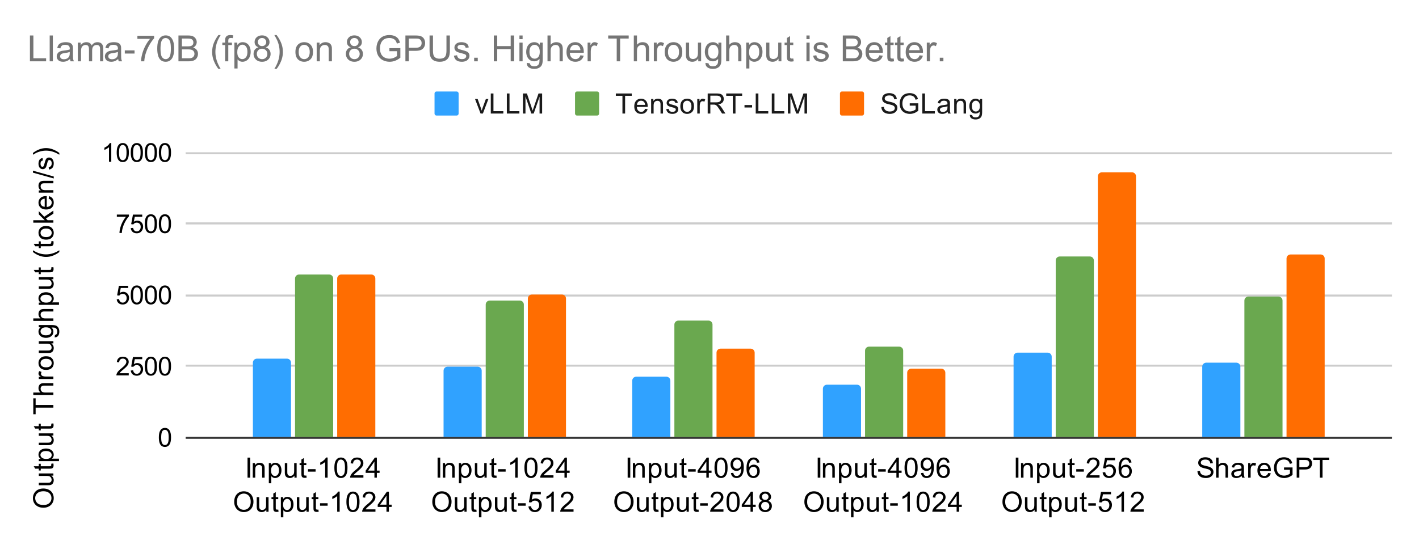
Technique 3: Low overhead CPU scheduling
Idea: Vectorize CPU operations / Overlap CPU scheduling
Results: Our python runtime matches C++ runtime and outperforms other python runtime by up to 3x.
Source: SGLang v0.2 blog, https://lmsys.org/blog/2024-07-25-sglang-llama3/

Slide 23
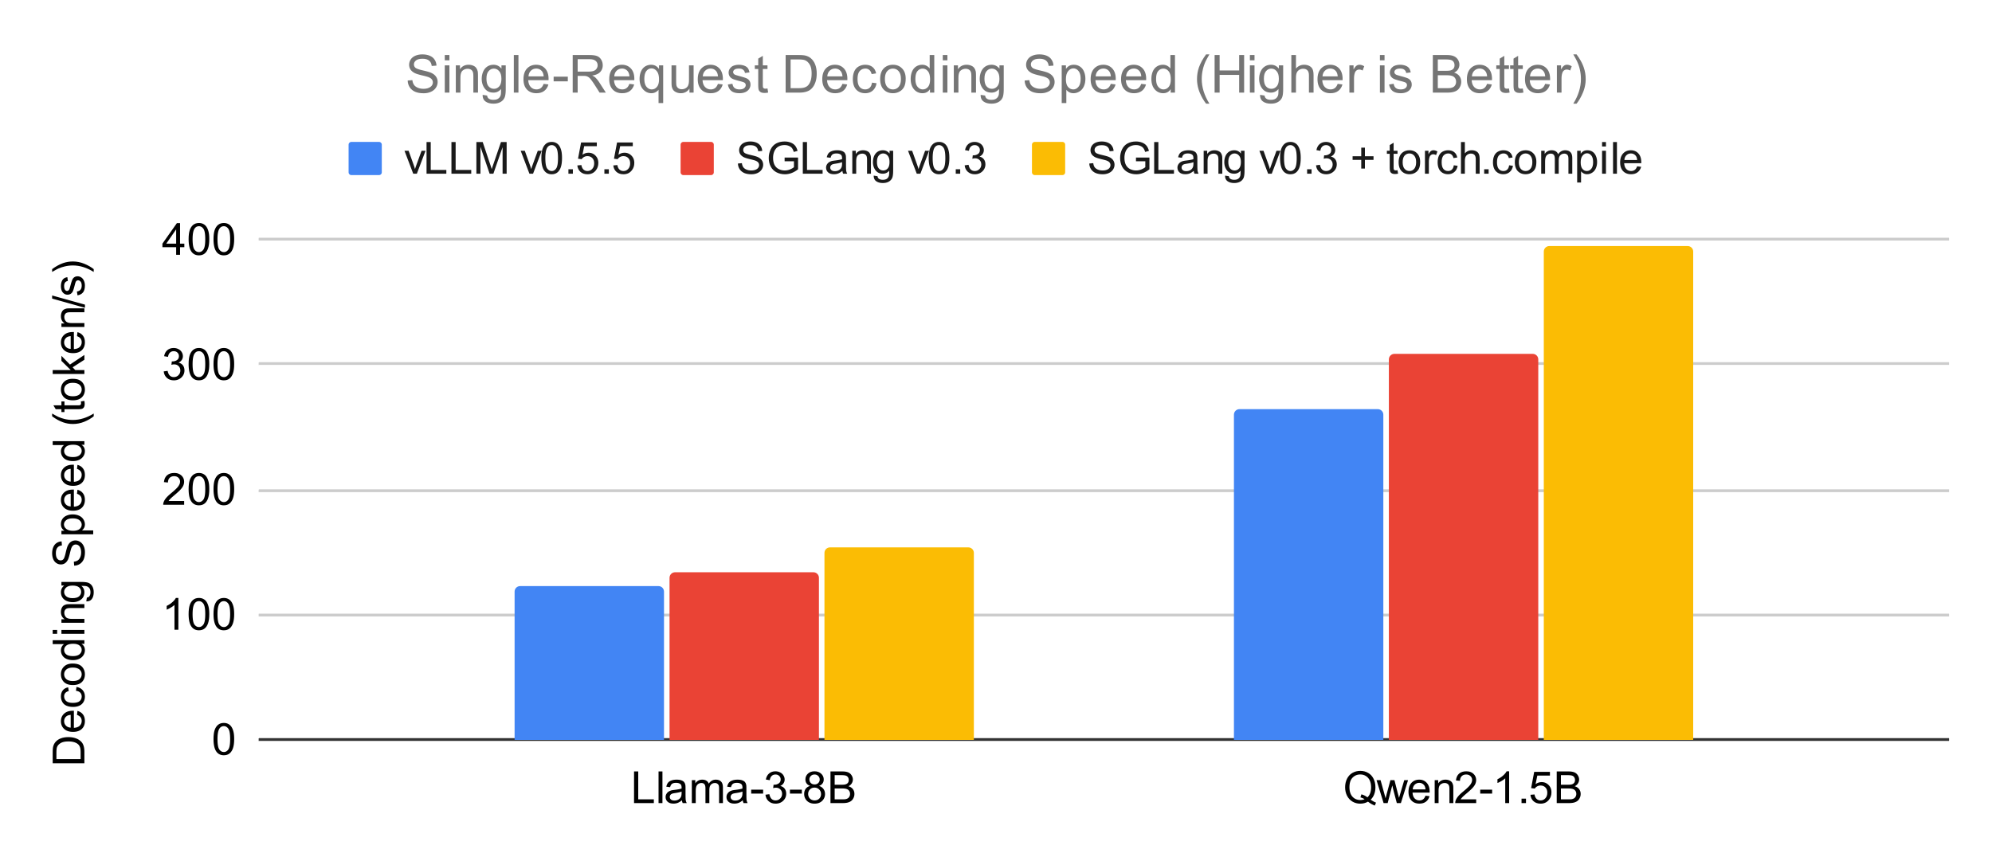
Technique 4: PyTorch-native optimizations
1.5x faster decoding with torch.compile
1.3x faster decoding with torchao int4 quantization (vs. fp8)
Source: SGLang v0.3 blog, https://lmsys.org/blog/2024-09-04-sglang-v0-3/

Slide 24
Preliminary benchmark results on MI300

Slide 25
Grok-1 (314B MoE, FP8) with SGLang on MI300
Setup: both use the triton attention backend. H100 runs TP=8, MI300 runs 2 x TP=4 thanks to its larger memory.
Preliminary results after one week of optimization. MI300 already shows promising results.
Data and integration contributed by the AMD team

Slide 26
Open-source community and roadmap

Slide 27












Community users and contributors

Slide 28
Roadmap
Performance optimizations
Sequence parallelism and sparse attention for long context inference
Adaptive speculative decoding for all batch sizes
Disaggregated prefill and decoding
Hierarchical radix cache
Faster grammar parsing libraries
Communication and CPU overhead overlapping
Modular design
Integrate PyTorch-native optimizations
Community building
Bi-weekly online development meeting

Slide 29



Acknowledgment
AMD technical
support
Xiao Hai
Anush Elangovan
Soga Lin, Wun-guo Huang
Core developers: Ying Sheng, Liangsheng Yin, Yineng Zhang, Ke Bao
SGLang open-source
contributors

Slide 30
Question & Answer
Github: https://github.com/sgl-project/sglang
Paper (NeurIPS’24) : https://arxiv.org/abs/2312.07104
Welcome to join the slack and bi-weekly dev meeting!

